Slide 1

HAP780 - FINAL PROJECT
COURSE TAUGHT BY Prof. SANJA AVRAMOVIC
LAKSHMI INDIRA KUPPA
G01451480
GEORGE MASON UNIVERSITY

Slide 2
Project – Data Analysis on Drug Review Dataset
The dataset contains 215,063 instances with 6 features, focusing on patient reviews of specific drugs, associated conditions, and patient satisfaction ratings on a 10-star scale.
The project involves binarizing the rating column and classifying the data using various algorithms in Weka.
This dataset, which is multivariate and text-based, falls within the subject area of Health and Medicine. The associated tasks primarily involve classification using the binarized ratings, with features represented as integers.
This setup is particularly suitable for predictive modeling in the healthcare domain, leveraging patient feedback to gain insights.

Slide 3
What might be the value of Analyzing Drug Review Data?
Analyzing drug review data is invaluable for several reasons:
Understanding Patient Satisfaction: Patient satisfaction is a key metric in healthcare that reflects the quality of care and the effectiveness of treatments. By analyzing patient reviews, healthcare providers can gauge overall satisfaction levels and identify areas where improvements are needed.
Assessing Drug Efficacy: Drug efficacy is traditionally assessed through clinical trials, but real-world effectiveness can vary. Patient reviews provide insights into how well a drug works across different populations and conditions, offering a broader perspective on its performance.
Identifying Potential Side Effects: Clinical trials may not capture all potential side effects, especially rare or long-term effects. Patient reviews can highlight side effects that might not have been apparent during trials, enabling healthcare providers to better inform patients and manage expectations.
Tailoring Treatments: Analyzing reviews can help in identifying which drugs work best for certain conditions or patient demographics. This information can be used to tailor treatments to individual patient needs, enhancing personalized medicine approaches.

Slide 4
The primary objectives of this project are:
To analyze the reviews to determine the general sentiment of patients regarding specific drugs and their associated conditions.
To evaluate the overall patient satisfaction by examining the distribution of ratings across different drugs and conditions.
To identify key trends and patterns in the data, such as commonly reported side effects, effectiveness of drugs for specific conditions, and the usefulness of reviews as indicated by other users.
To develop a predictive model that could help in forecasting patient satisfaction with a drug based on the review content and associated features.

Slide 5
The analysis will be carried out through the following steps:
Data Preprocessing: Using SQL
Clean the dataset by addressing missing values, removing duplicates, and filtering out irrelevant data.
Convert categorical variables, such as drug names and conditions, into numerical formats for further analysis.
Process the review text to extract key features, including sentiment, common terms, and underlying themes.
Exploratory Data Analysis (EDA):
Examine the distribution of ratings to identify drugs with the highest and lowest levels of patient satisfaction.
Sentiment Analysis:
Conduct sentiment analysis on the review text to categorize reviews as positive, negative, or neutral.
Predictive Modeling: Using Weka Software
Develop a predictive model using machine learning techniques to forecast patient satisfaction (ratings) based on drug names, conditions, and review content.
Assess the model’s accuracy and refine it as needed.

Slide 6
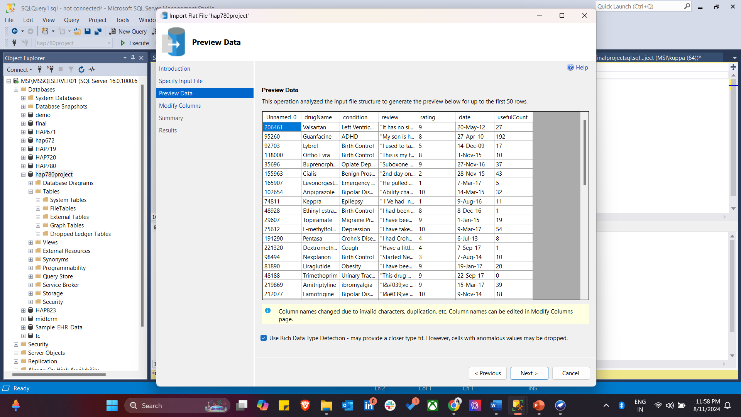
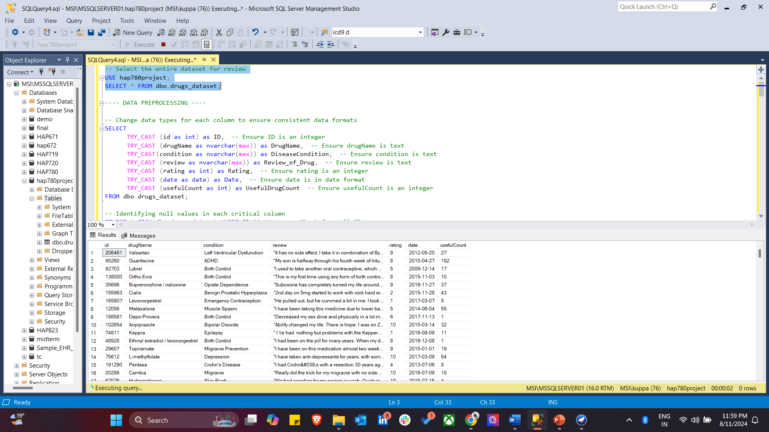
Step 1: Import Data, Initial Data Review
First step in Data Preprocessing where data is reviewed to understand its structure.

Slide 7
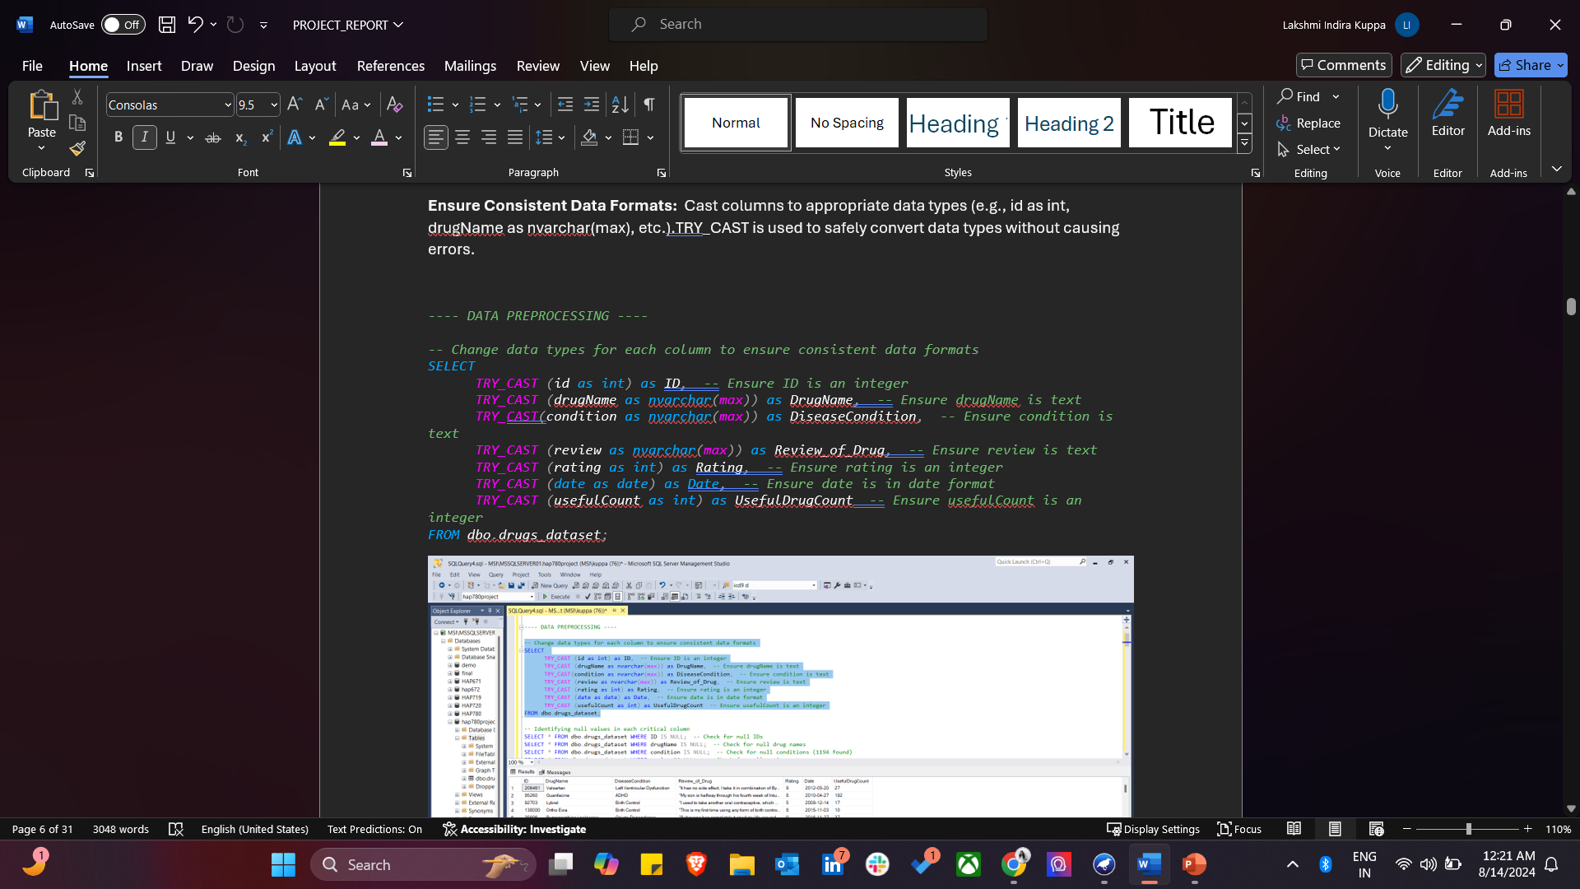
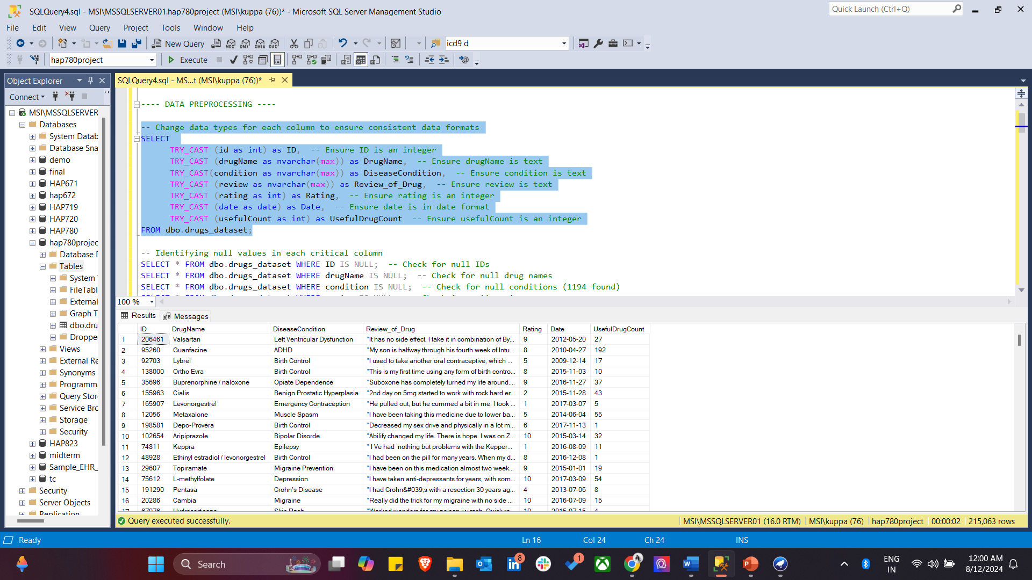
Step 2: Data Standardization
Consistent data formats are ensured by casting each column to the appropriate data type. The SQL TRY_CAST function is used to convert columns like id, drugName, condition, and rating to their correct formats (e.g., integer, text, date), ensuring that the data is uniformly structured for subsequent analysis. This step is critical for maintaining data integrity and avoiding errors during analysis.

Slide 8
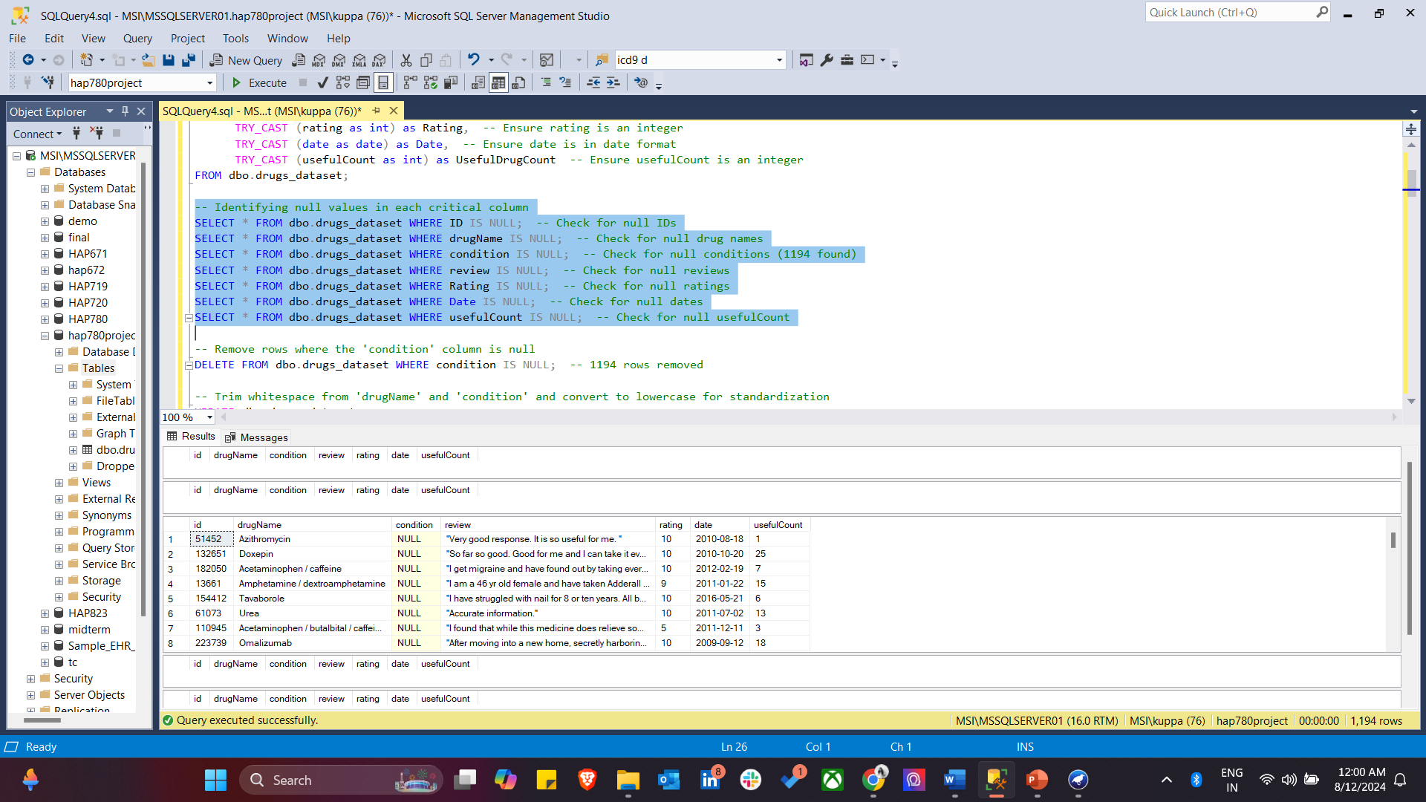
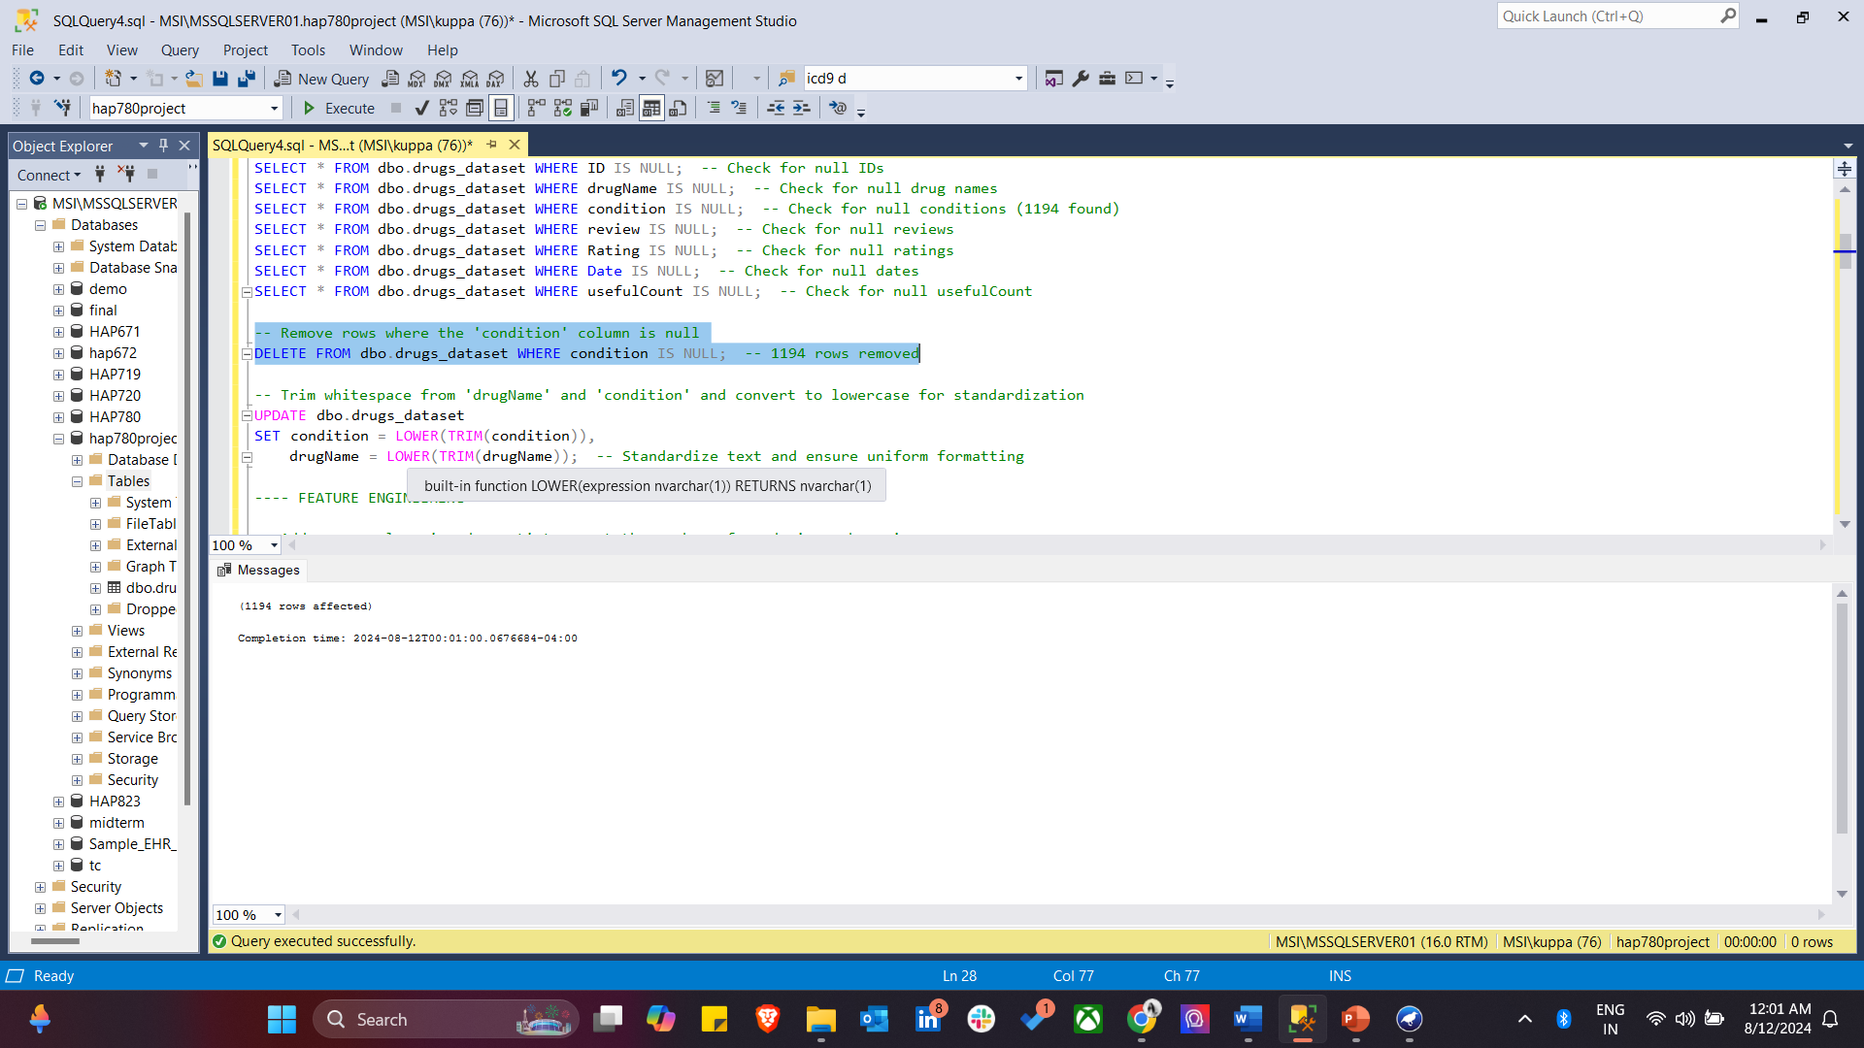
Step 3: Null Value Identification and Handling
To ensure data quality, null values are identified by checking critical columns such as ID, drugName, condition, review, Rating, Date, and usefulCount. Rows with null values in the condition column are removed to maintain the integrity of the dataset.

Slide 9
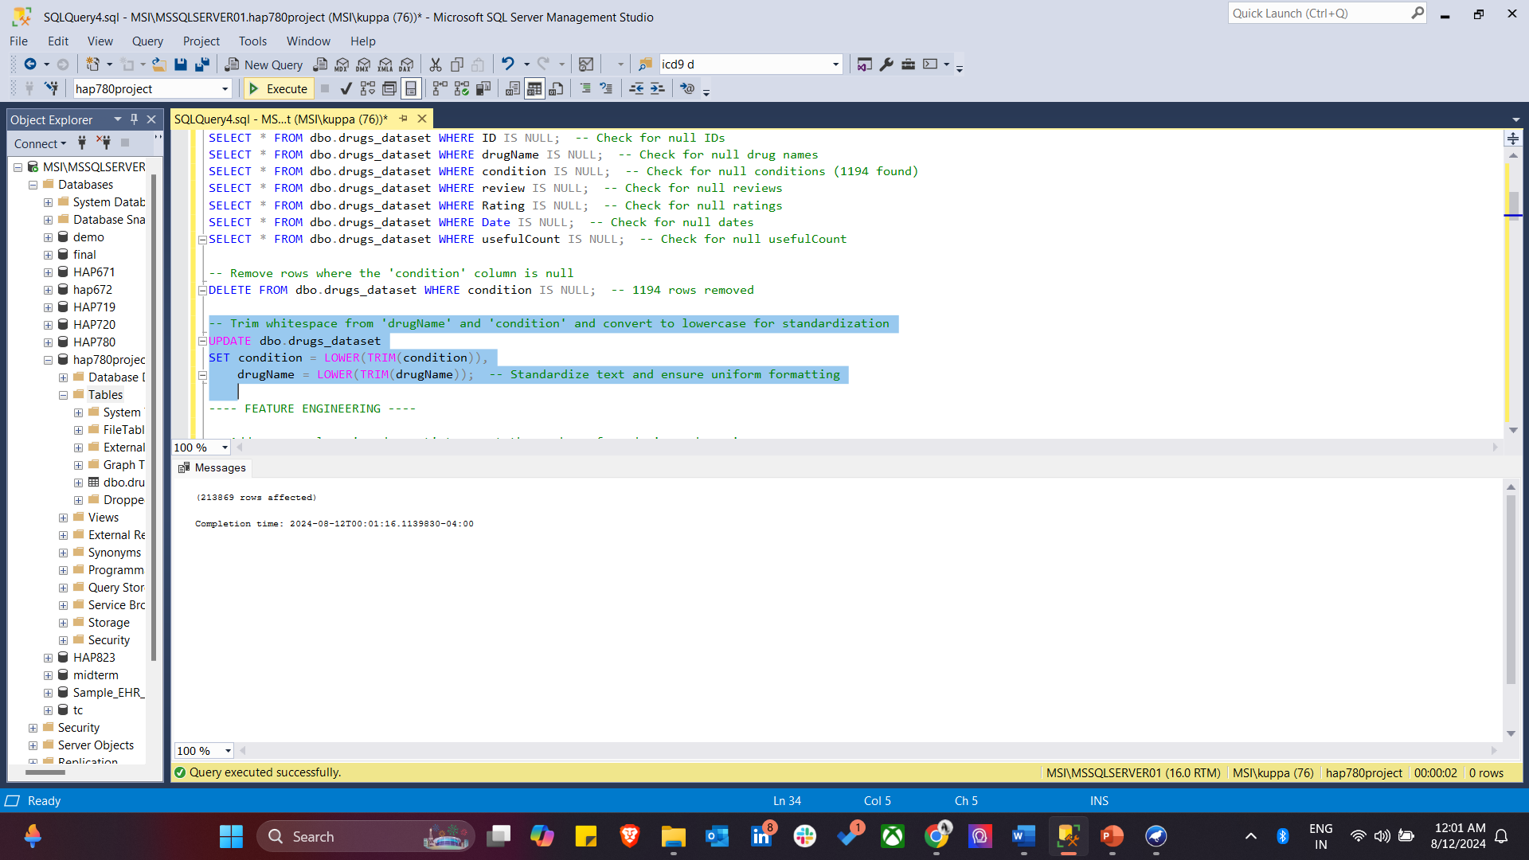
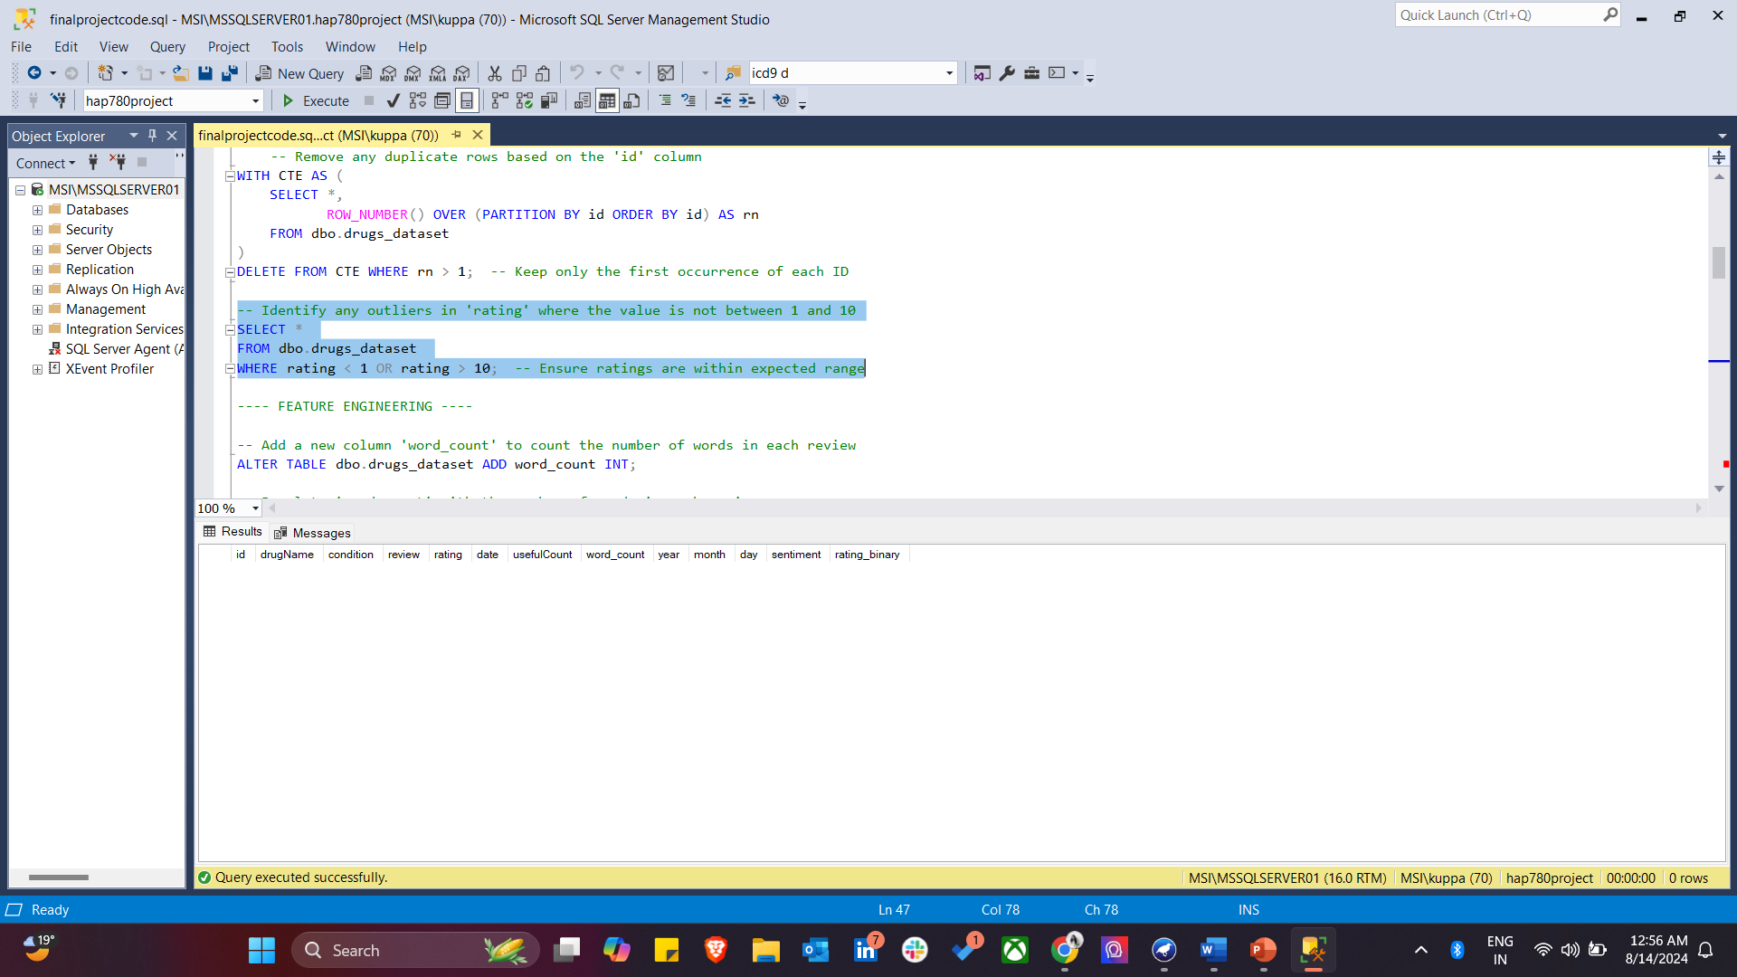
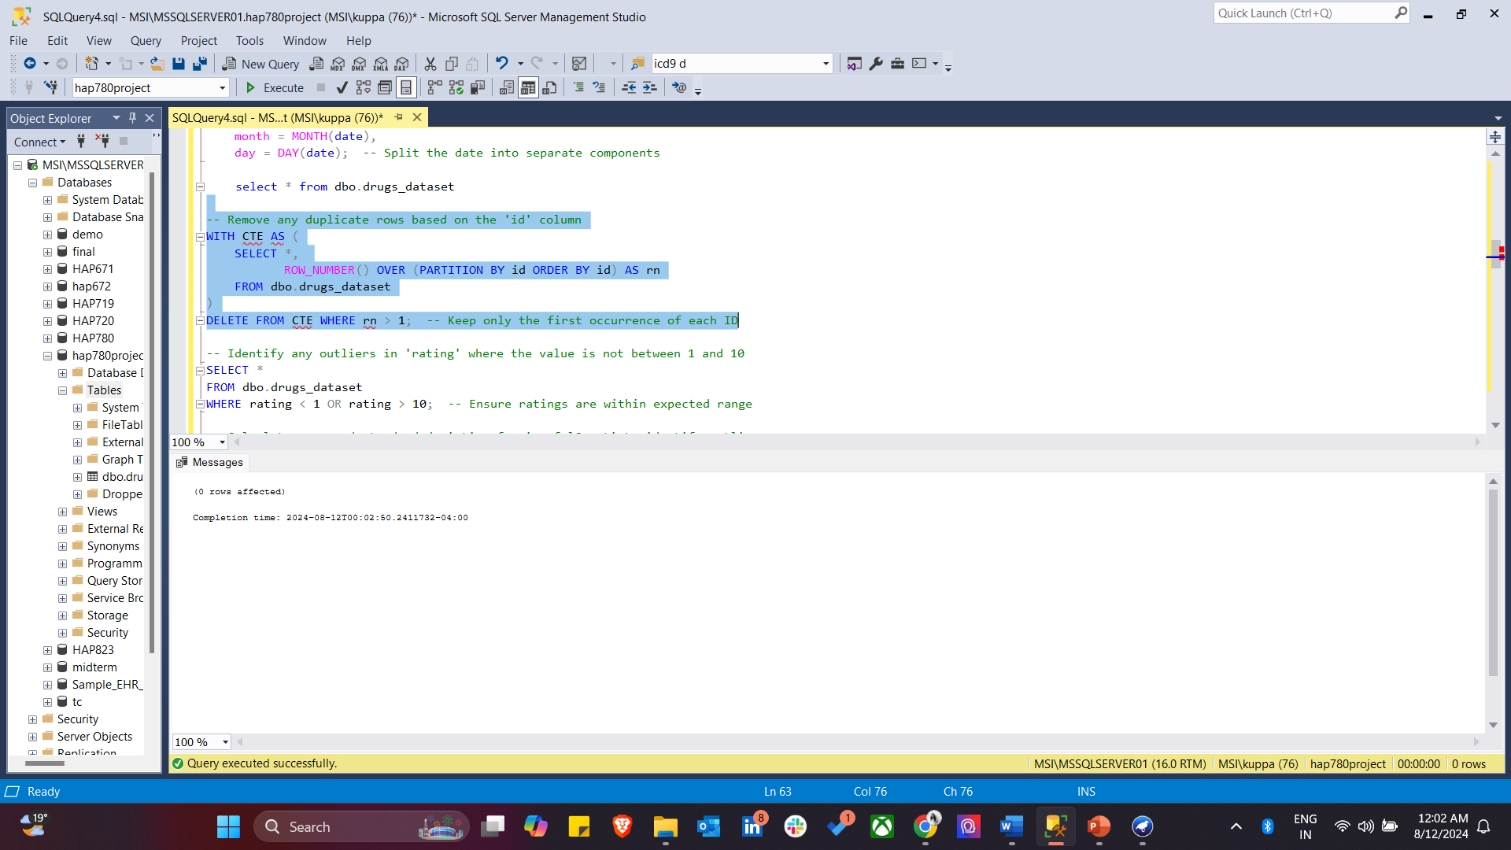
Step 4: Here, the SQL code standardizes the ‘drugname’ and ‘condition’ columns by trimming whitespace and converting text to lowercase, removes duplicate rows based on ‘id’ and identifies outliers in the ‘rating’ column by selecting values outside 1 to 10 range.

Slide 10
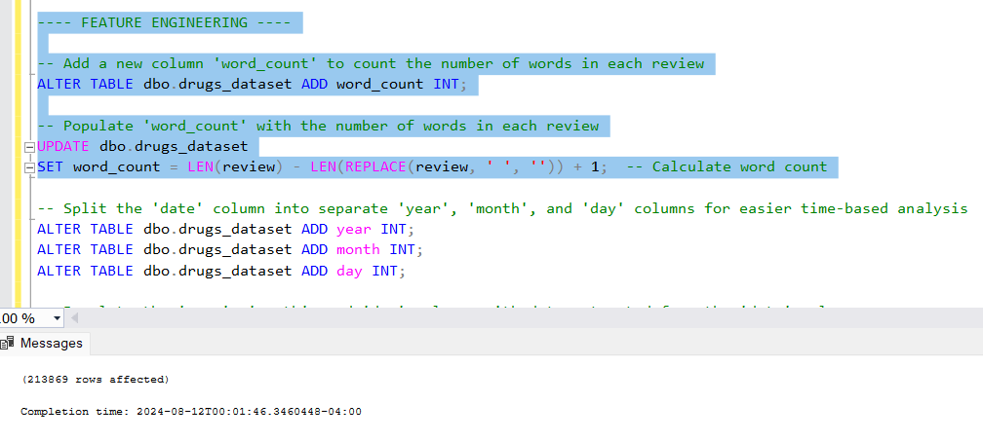
Step5 : Feature Engineering
This SQL code performs feature engineering by adding a new column called word_count to the drugs_dataset table. It then calculates and populates the word_count column with the number of words in each review, providing additional insight into the length of the reviews.

Slide 11
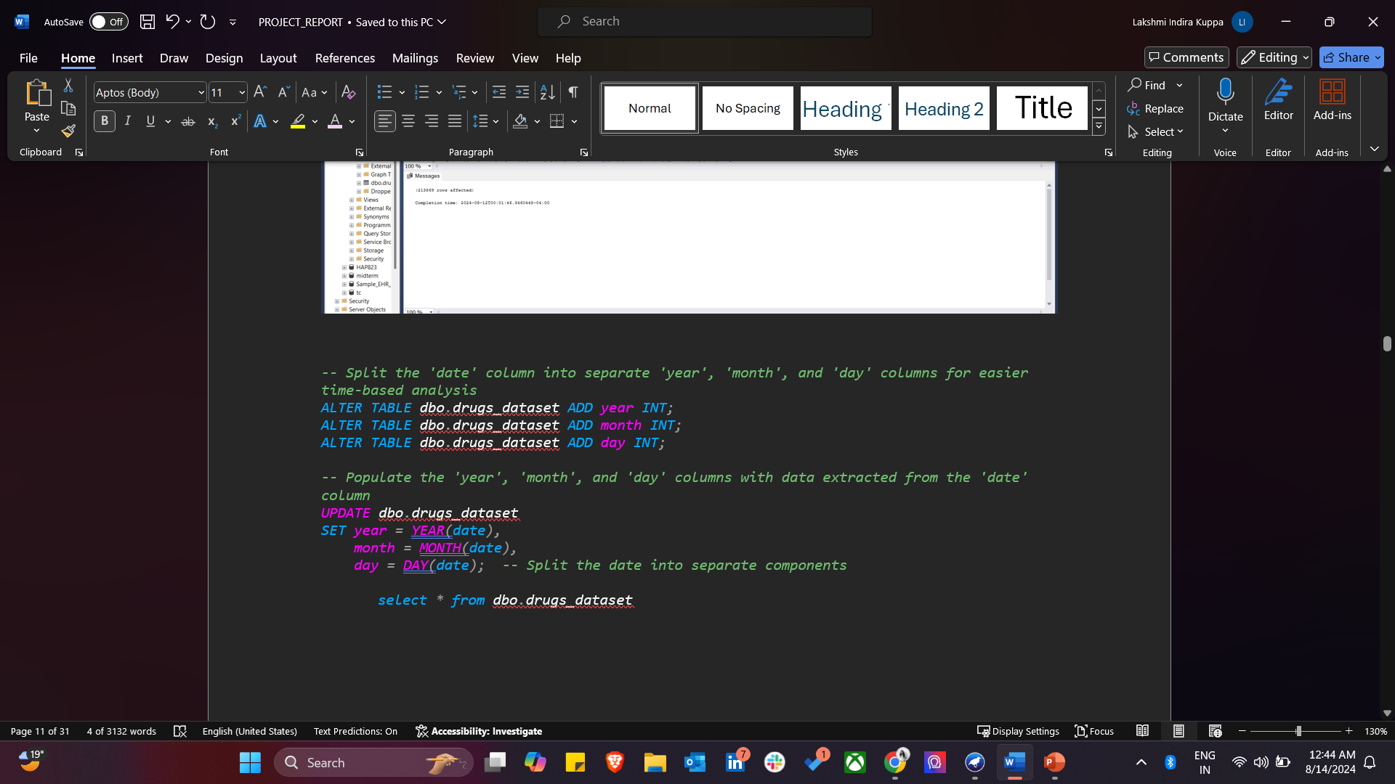
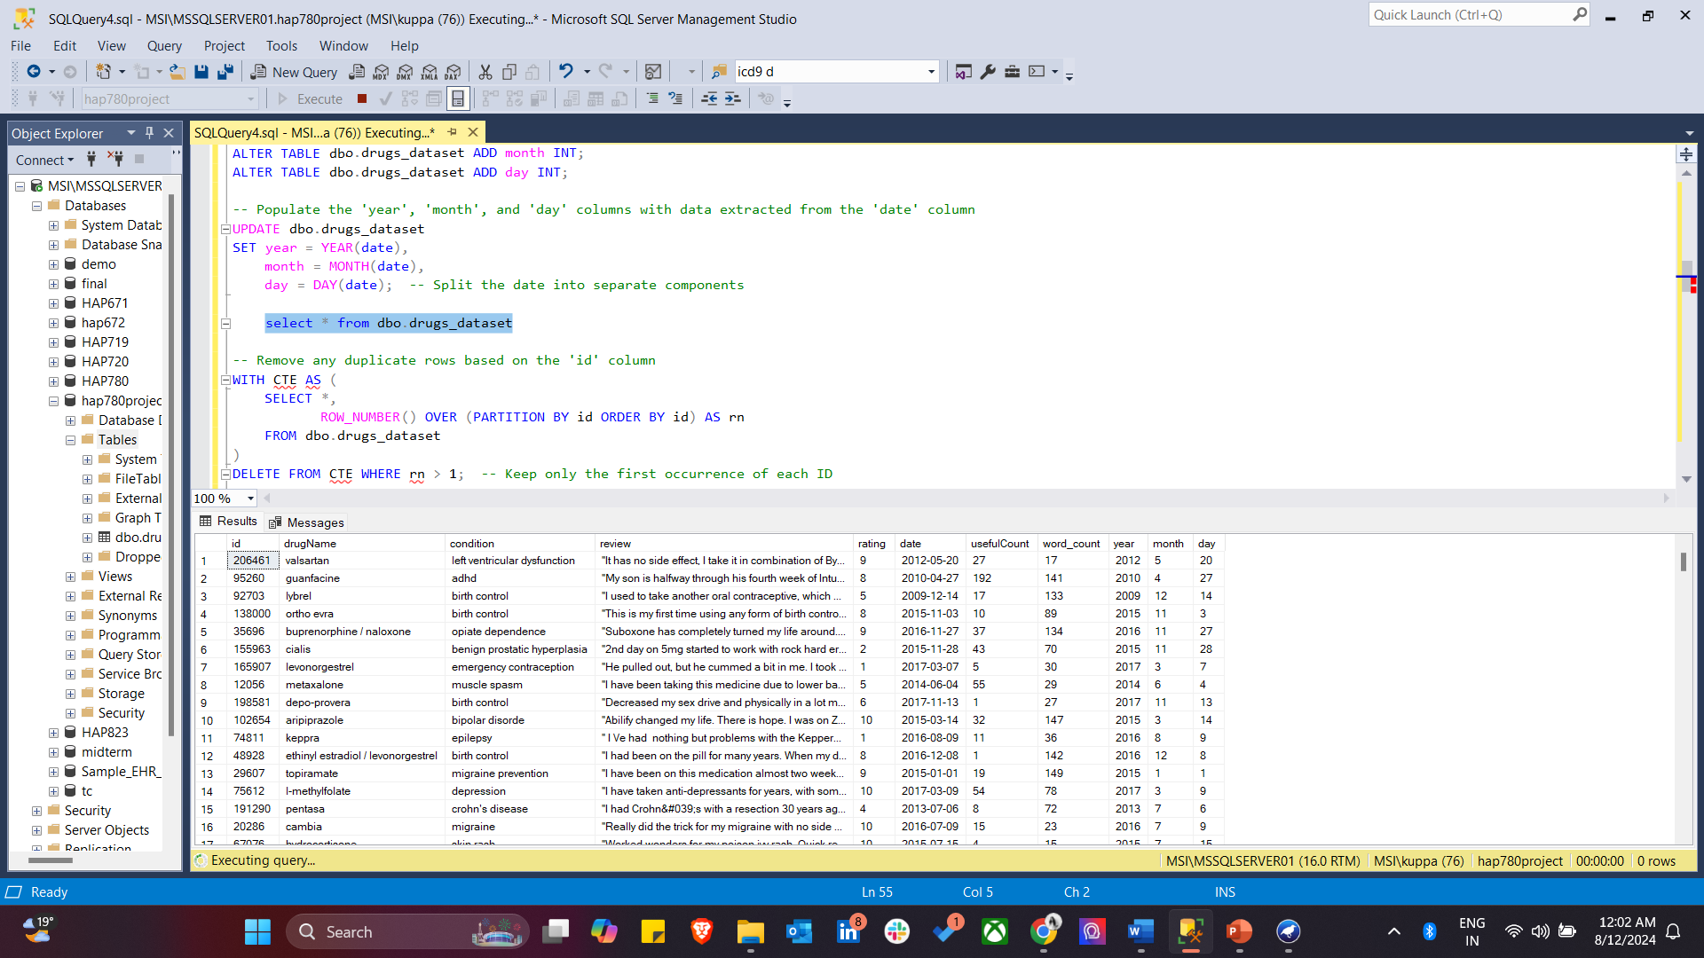
Step6: This code enhances time-based analysis by splitting the date column in the drugs_dataset table into three separate columns: year, month, and day. It then populates these new columns with the corresponding values extracted from the date column, making it easier to analyze the data by specific time components.

Slide 12
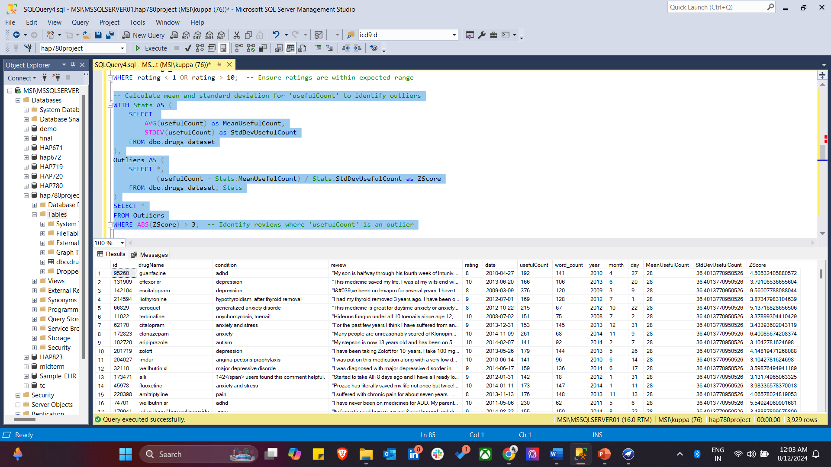
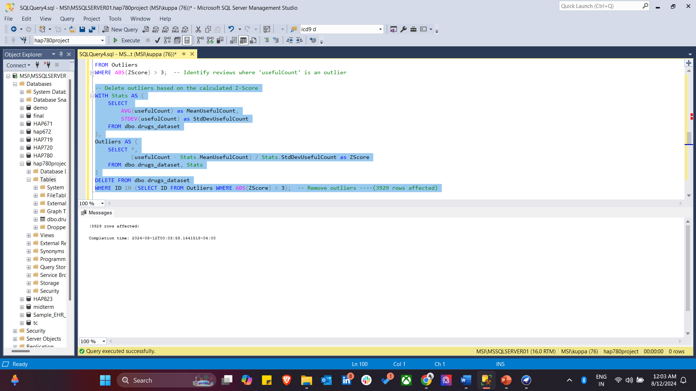
In this step7, I identified and removed outliers in the usefulCount column. I calculated the mean and standard deviation of usefulCount and then computed the Z-Score for each record to assess how far each value deviates from the mean. Records with a Z-Score greater than 3, indicating they are outliers, were identified and subsequently deleted from the dataset. This ensures that the data is free of extreme values that could potentially skew the analysis.

Slide 13
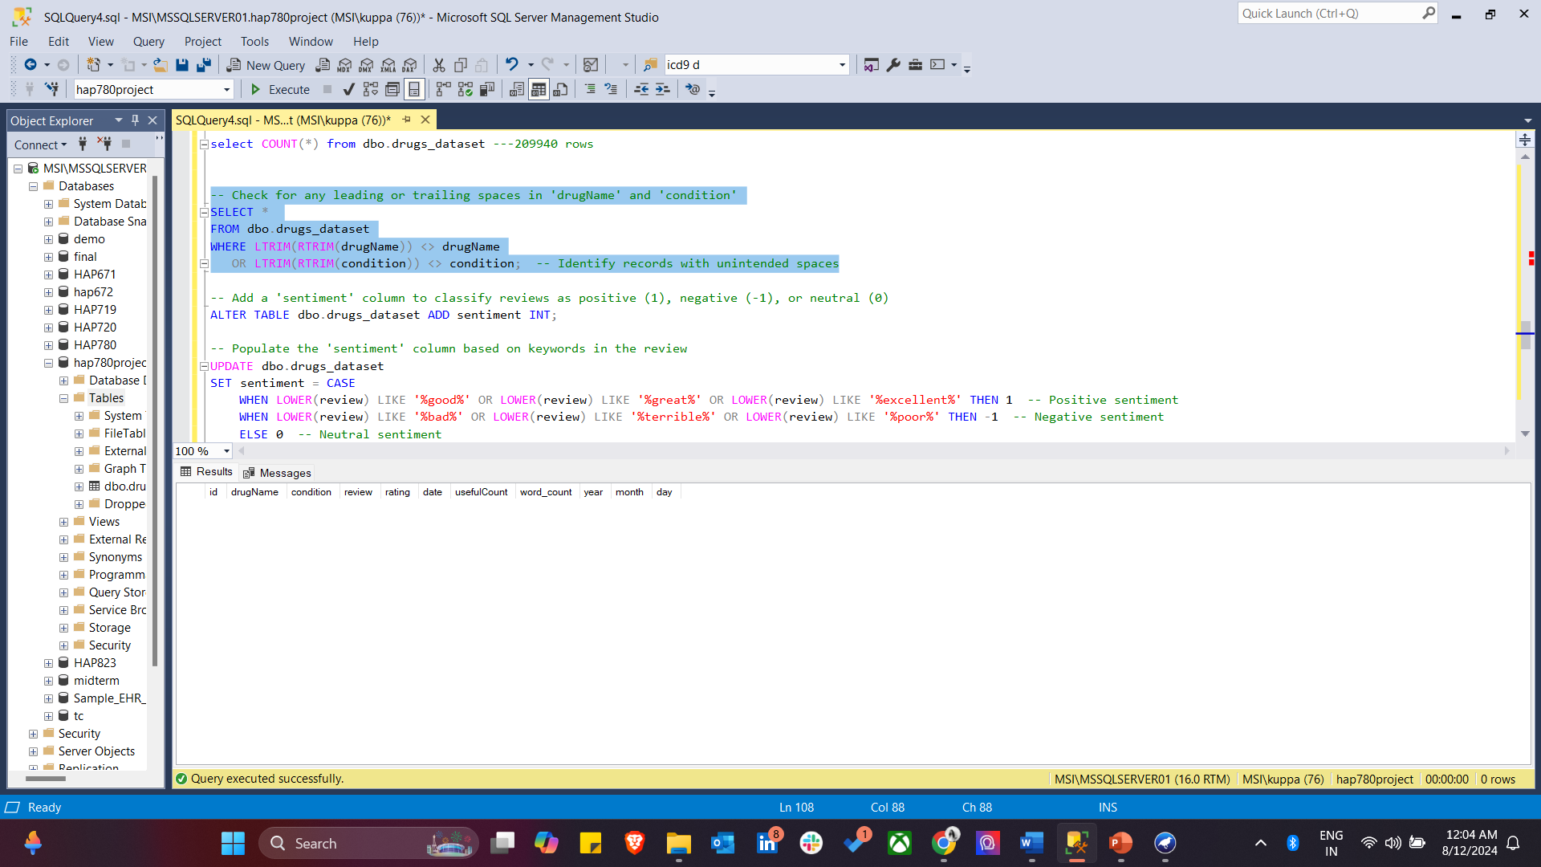
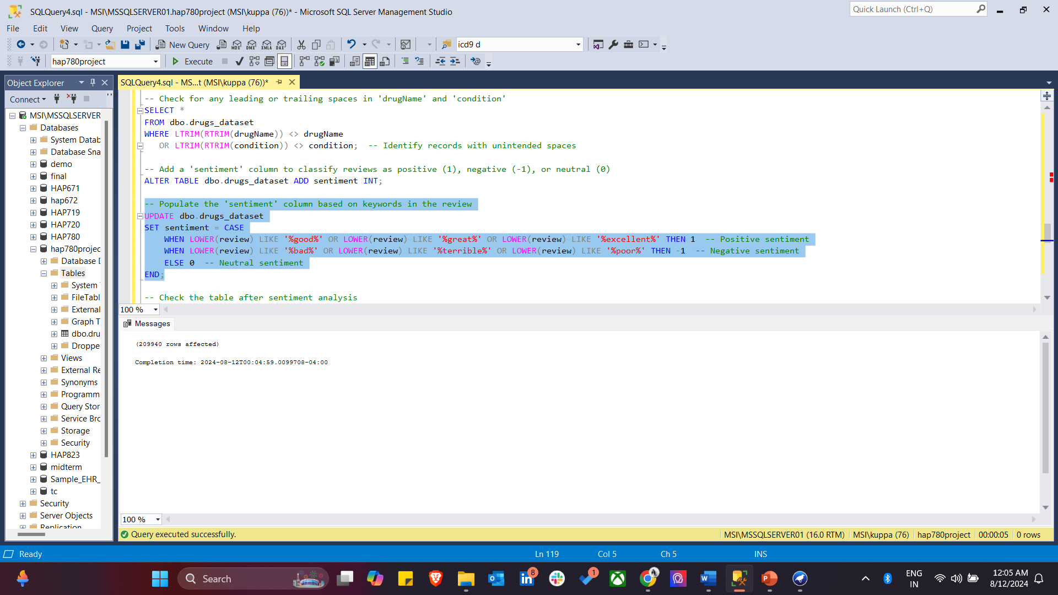
Step 8: I first checked for any leading or trailing spaces in the drugName and condition columns to identify records with unintended spaces that could affect data consistency. After ensuring the data was clean, I added a new sentiment column to classify reviews as positive, negative, or neutral. I populated this column based on keywords in the review text, assigning values of 1 for positive sentiment, -1 for negative sentiment, and 0 for neutral sentiment. This classification will help in analyzing the overall tone of the patient reviews.

Slide 14
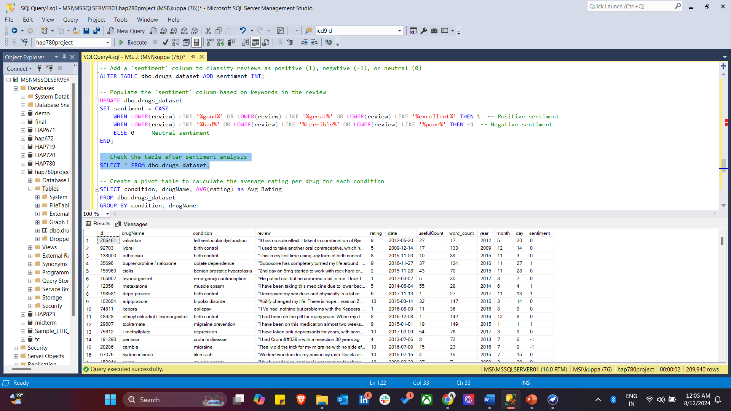
After sentiment analysis, we check the dataset. The sentiment attribute was categorized into three distinct classes: 1 for positive sentiment, 0 for neutral sentiment, and 0.5 for negative sentiment.

Slide 15
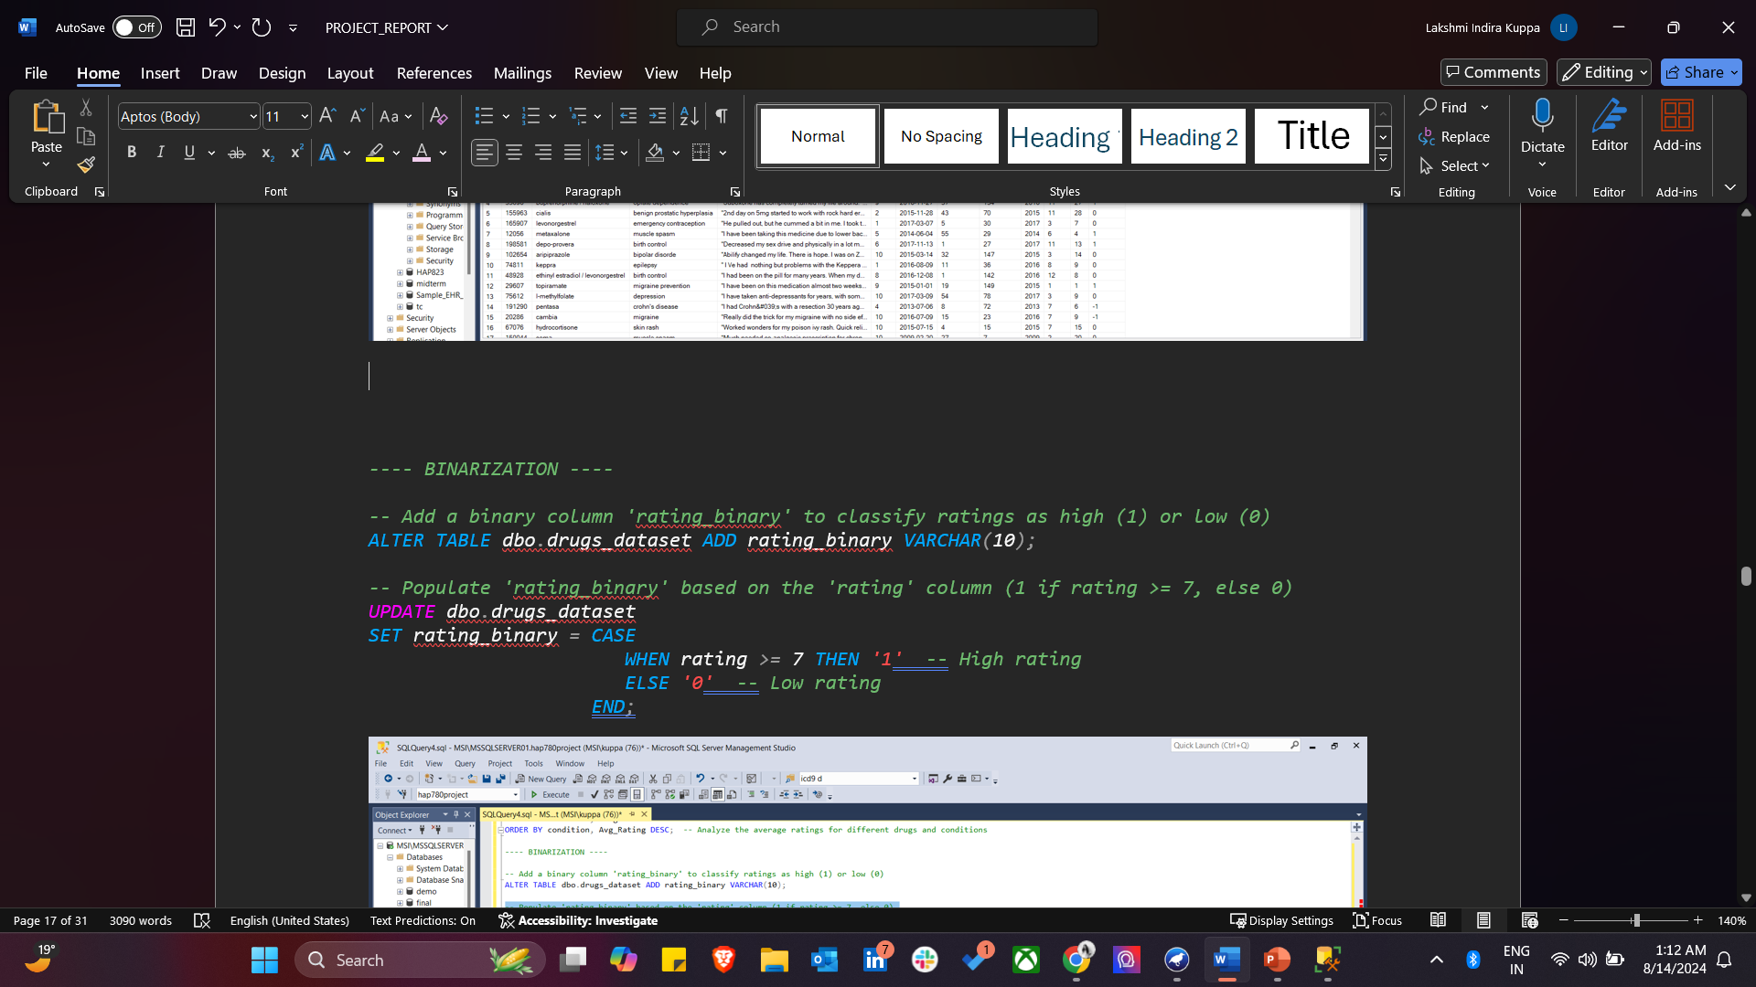
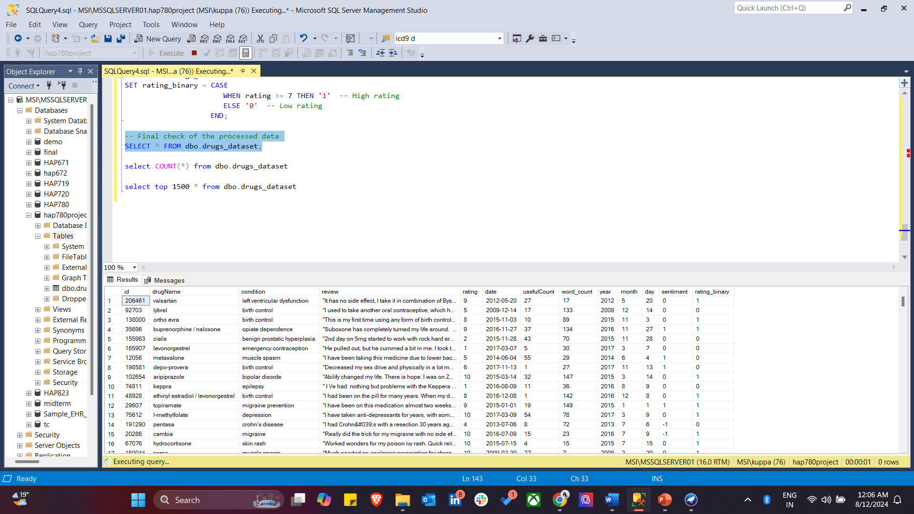
BINARIZATION

Slide 16
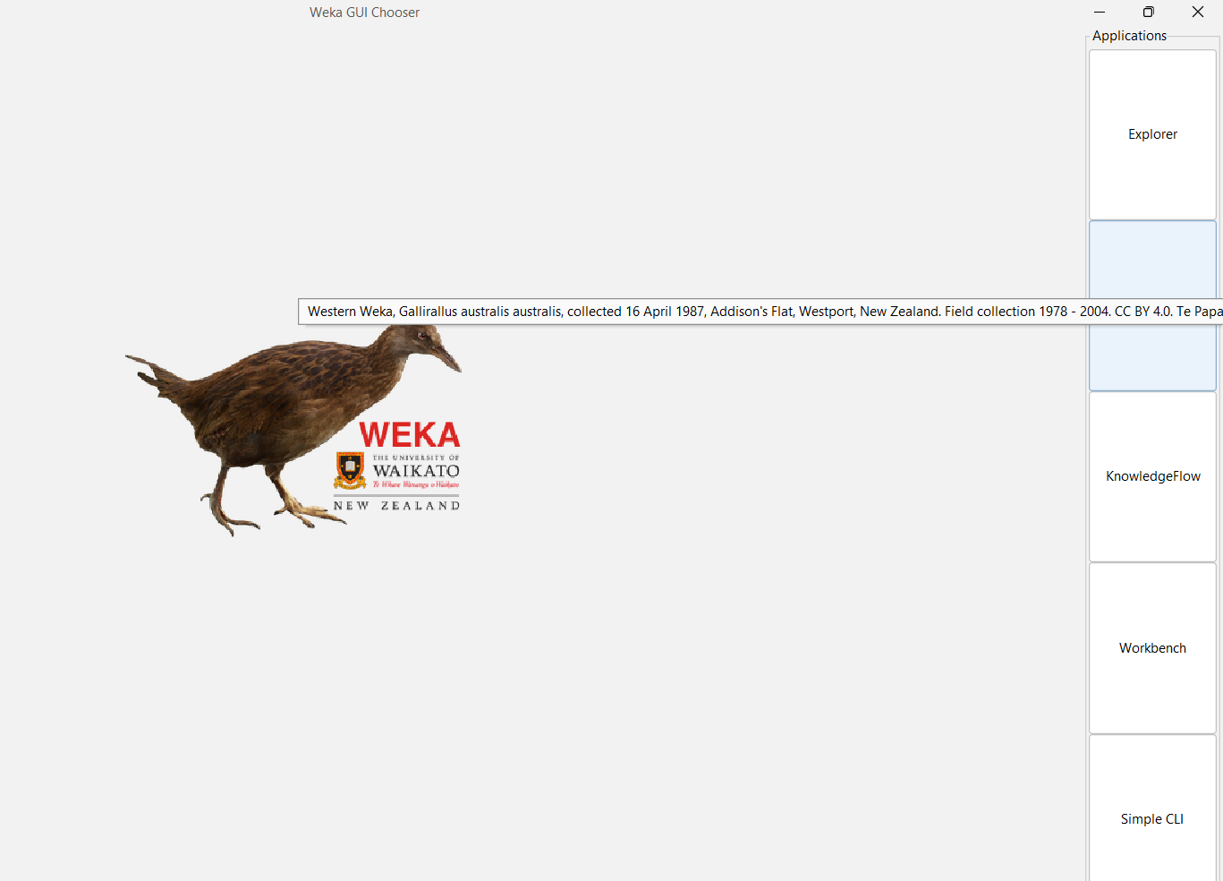
WEKA SOFTWARE

Slide 17
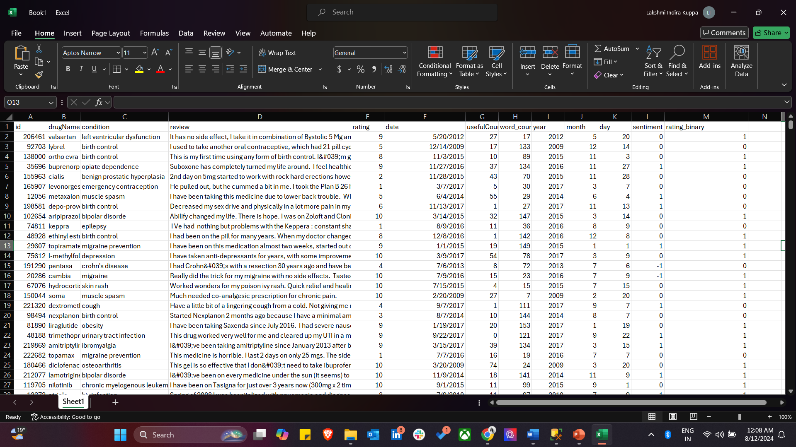
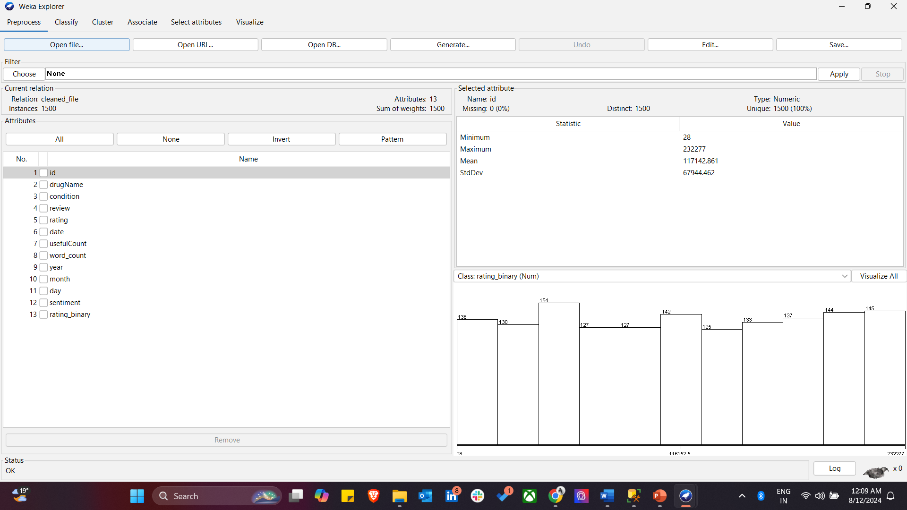
WEKA
After importing the CSV file into WEKA, I first reviewed the data, then converted the relevant attributes from numeric to nominal, and normalized the variables to ensure consistent scaling across the dataset.

Slide 18
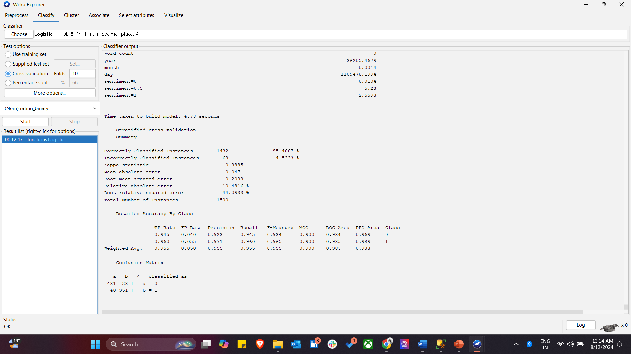
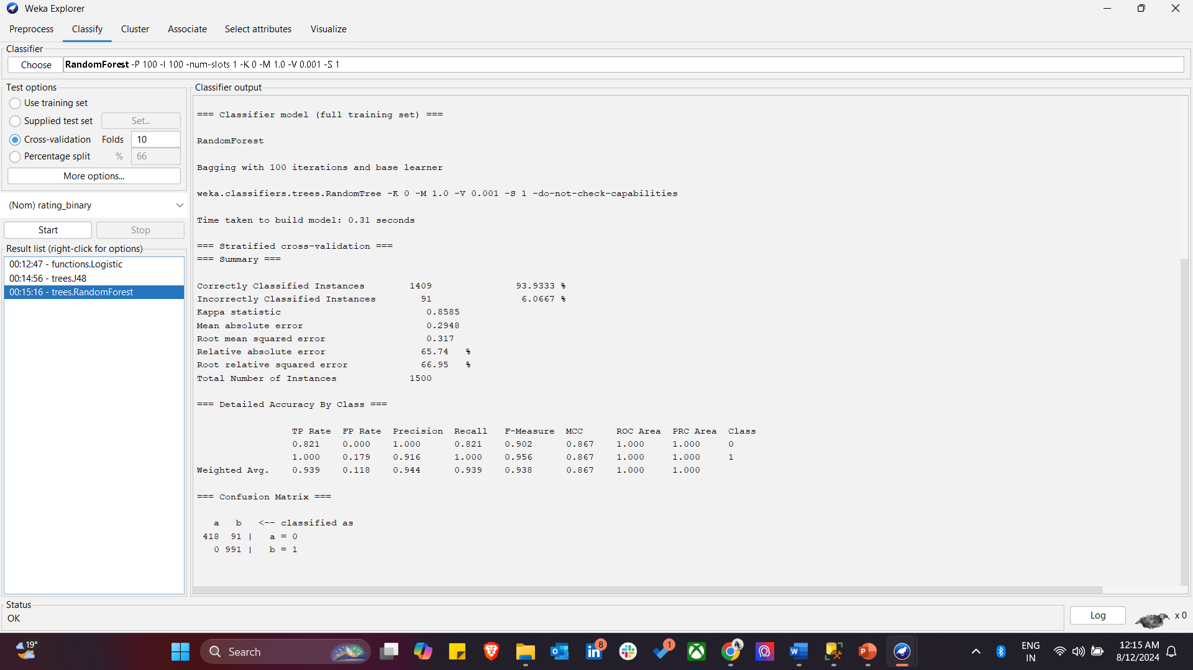
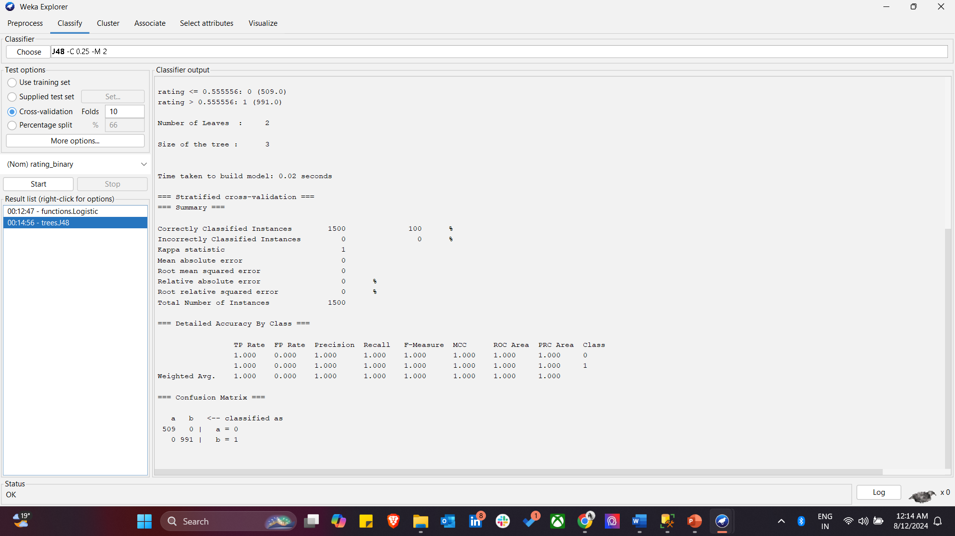
PREDICTIVE MODELLING USING CLASSIFICATION ALGORITHMS
LOGISTIC
J48
RANDOMFOREST

Slide 19
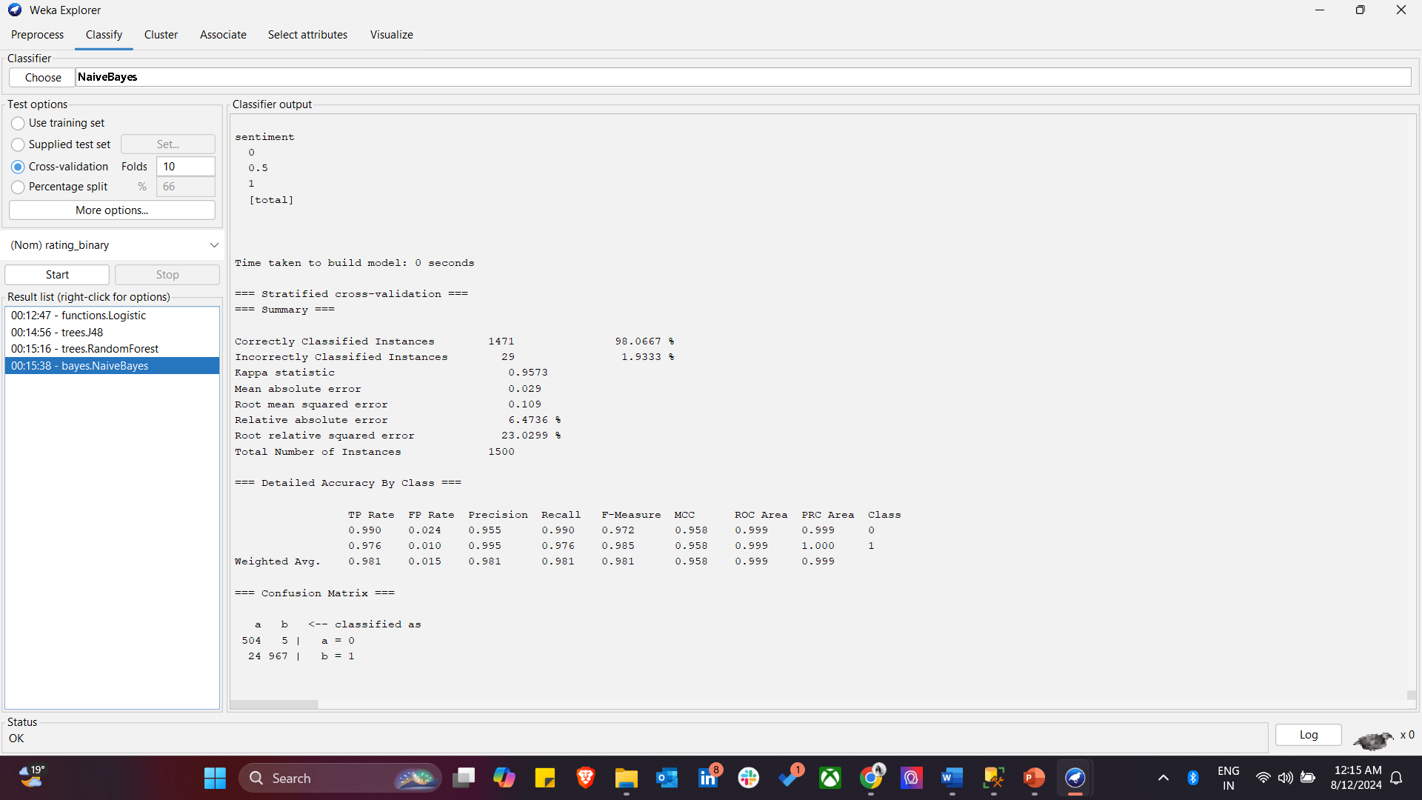
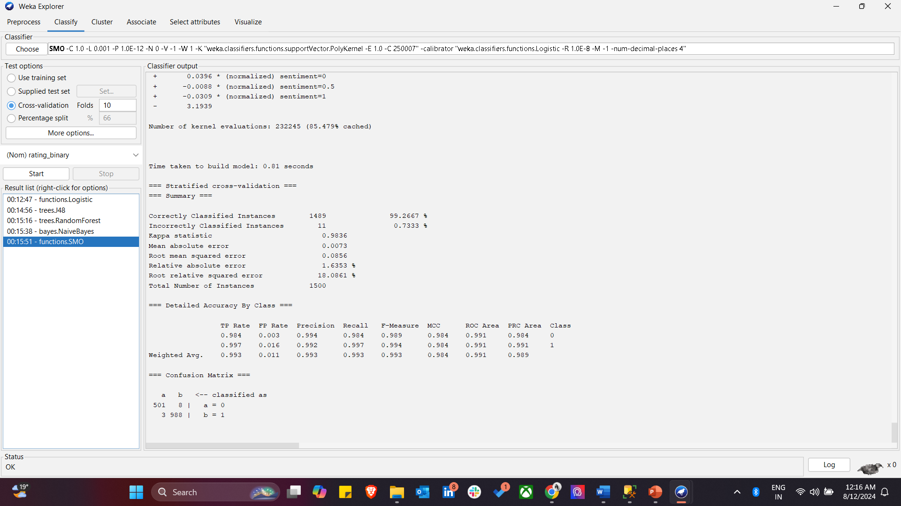
NAIVES BAYES
SUPPORT VECTOR MACHINE

Slide 20
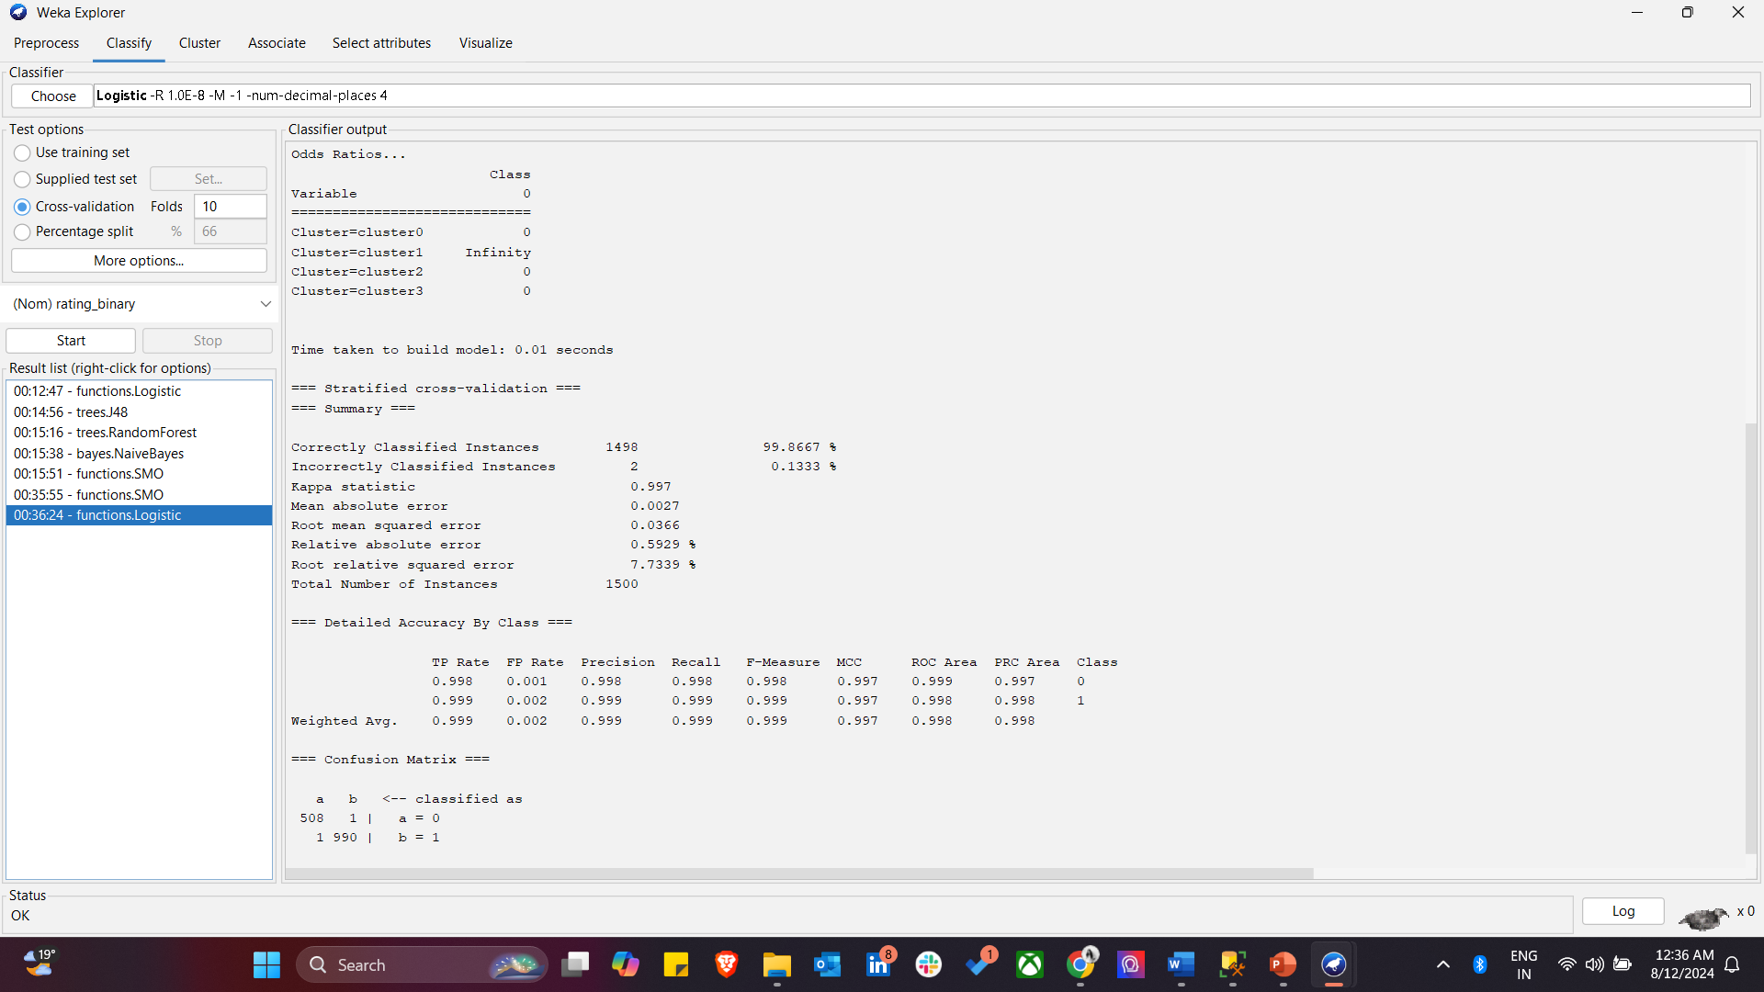
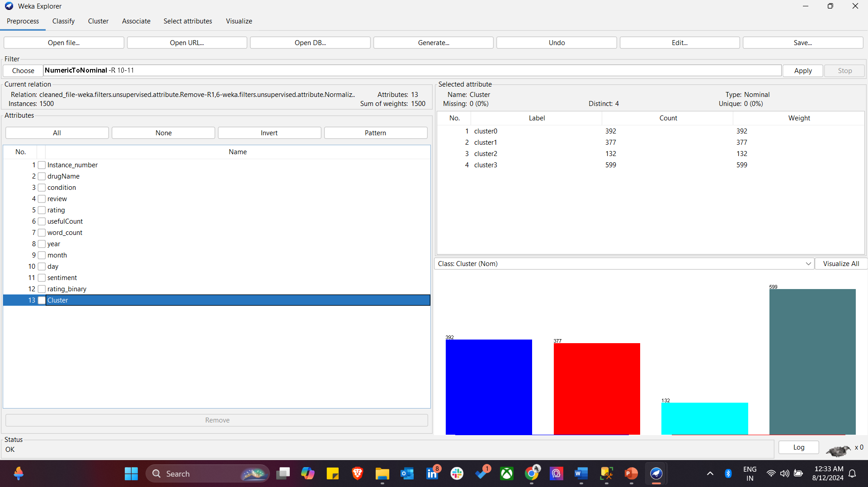
CLUSTERING
In this analysis, clustering was utilized to organize similar data points according to their shared characteristics. After performing the clustering, the dataset was divided into four distinct clusters: Cluster 0 with 392 instances, Cluster 1 with 377 instances, Cluster 2 with 132 instances, and Cluster 3 with 599 instances. These clusters were then analyzed to reveal how different instances, such as various drugs, associated conditions, or patient sentiments, were grouped together. Clustering not only simplifies the dataset but also enhances the accuracy of subsequent analyses. When combined with classification techniques, clustering can improve the performance of predictive models by grouping similar instances, thereby providing a more nuanced understanding of the data.

Slide 21
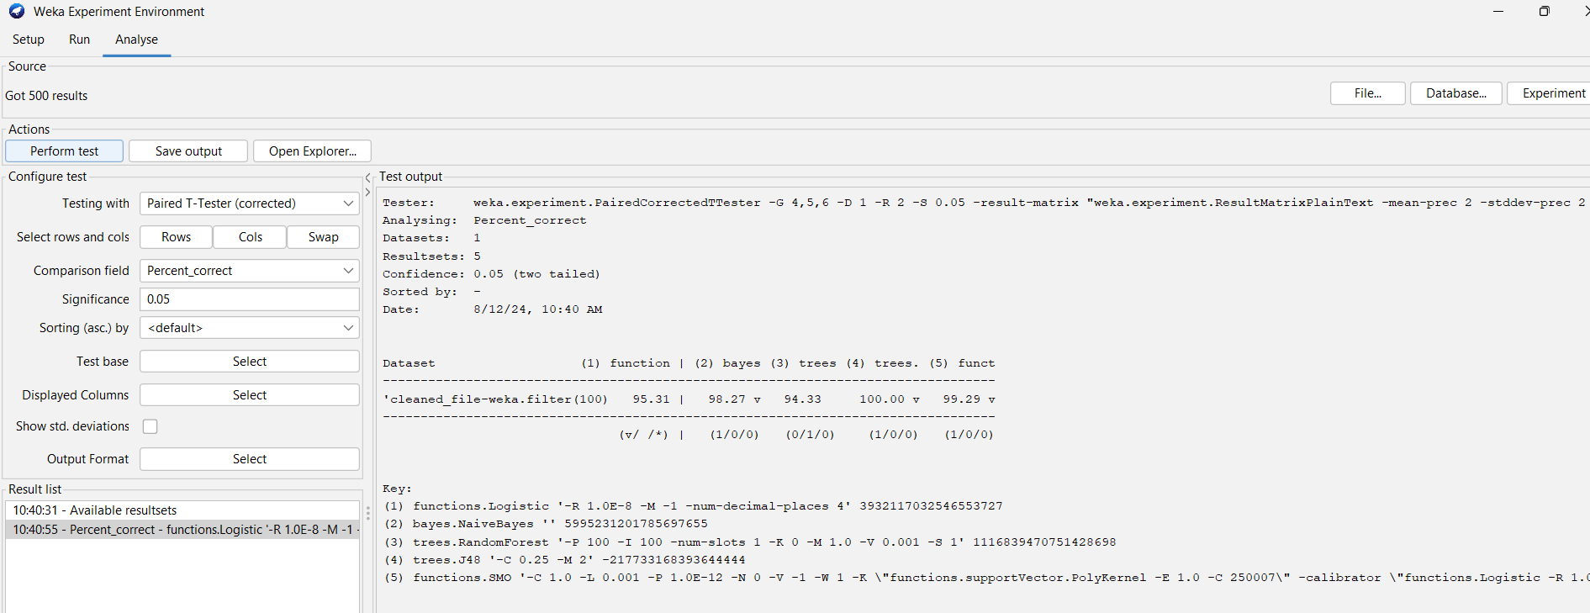
WEKA EXPERIMENTER
Results indicate that the J48 decision tree model achieved 100% accuracy, while the other models, including Logistic Regression, Random Forest, Naive Bayes, and SMO, also performed well but with slightly lower accuracy.

Slide 22
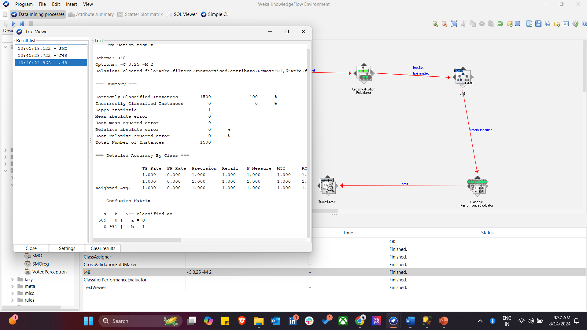
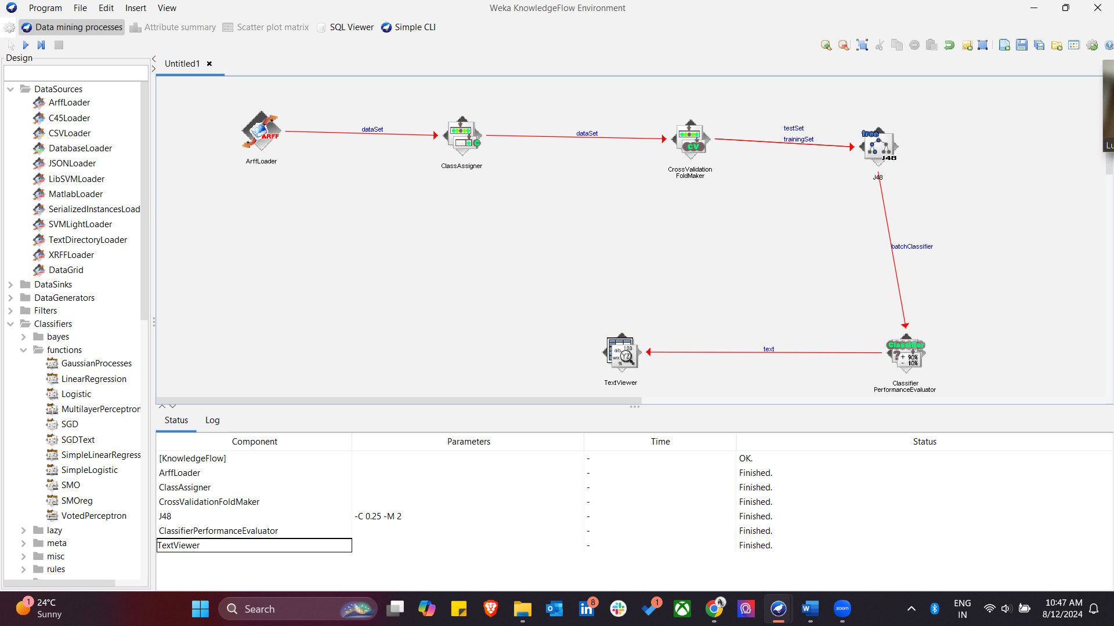
WEKA KNOWLEDGE FLOW

Slide 23
RESULTS
The J48 Decision Tree model demonstrates the best overall performance, achieving 100% accuracy, precision, recall, F-measure, and ROC Area. This means it perfectly classified all instances in the dataset without any errors. The model stands out because it attained perfect scores across all metrics, indicating that it correctly identified all instances in both classes with no false positives or negatives.
Model | Precision (Class 0) | Precision (Class 1) | Recall (Class 0) | Recall (Class 1) | ROC Area
Logistic Regression | 0.923 | 0.971 | 0.945 | 0.960 | 0.985
J48 Decision Tree | 1.000 | 1.000 | 1.000 | 1.000 | 1.000
Random Forest | 1.000 | 0.916 | 0.821 | 1.000 | 1.000
Naive Bayes | 0.955 | 0.995 | 0.990 | 0.976 | 0.999
SMO (SVM) | 0.994 | 0.992 | 0.984 | 0.997 | 0.984

Slide 24
These tables provide a clear summary of the sentiment and satisfaction levels associated with the drugs in your dataset, helping to highlight the overall perception and effectiveness of the drugs according to patient reviews.
SENTIMENT CLASS | TYPE | INSTANCES
1 | POSITIVE | 313
0 | NEUTRAL | 987
-1 | NEGATIVE | 200
RATING CLASS | TYPE | INSTANCES
1 | HIGH | 991
0 | LOW | 509

Slide 25
CONCLUSION
In this analysis, the primary objective was to predict patient satisfaction ratings for various drugs using a binarized version of the rating variable. The rating variable, originally on a 10-star scale, was binarized into two categories: high (1) for ratings 7 and above, and low (0) for ratings below 7. This binarization allowed for a clearer distinction between highly satisfactory and less satisfactory drug reviews, making it easier to classify and analyze the data.
The analysis revealed that the J48 Decision Tree model, even without clustering, was the most effective in predicting patient satisfaction ratings based on the available variables. The model's perfect classification performance suggests that the predictors (drug name, condition, review text, useful count, and sentiment) were highly indicative of the binarized ratings.
The inclusion of clustering did not significantly enhance the performance of the classification models. While clustering helps in identifying natural groupings within the data and can improve model interpretability, the classification accuracy was already near perfect with models like J48 even without clustering.

Slide 26
Applications and Future Implications
The insights derived from this analysis have the potential to benefit both healthcare providers and patients. For instance:
For Patients: An application developed based on the predictive model could allow patients to enter their condition and receive personalized drug recommendations based on aggregated patient reviews and satisfaction data. This could empower patients to make more informed decisions about their treatments.
For Healthcare Providers: Providers could use this data to better understand patient experiences with certain drugs and tailor their prescriptions, accordingly, leading to improved patient outcomes and satisfaction.
Future Research: This project can serve as a foundation for further research into patient satisfaction and drug efficacy, potentially leading to more refined and accurate predictive models.

Slide 27


References –
https://archive.ics.uci.edu/dataset/462/drug+review+dataset+drugs+com
https://www.drugs.com/medical_conditions.html
https://www.semanticscholar.org/paper/Aspect-Based-Sentiment-Analysis-of-Drug-Reviews-and-Gr%C3%A4%C3%9Fer-Kallumadi/4d7c25fe6131a79dfec9f45b70b270f400ac2b4f
https://towardsdatascience.com/sentiment-analysis-concept-analysis-and-applications-6c94d6f58c17
https://www.weka.io/learn/glossary/ai-ml/machine-learning/
https://ijiset.com/vol7/v7s10/IJISET_V7_I10_31.pdf
https://machinelearningmastery.com/use-machine-learning-algorithms-weka/

Slide 28
THANK YOU!

